Slide 1
Big Data
a bold adventure

Slide 2
Do You Have Big Data Experience?
Experience dealing with data and modeling outside of your local machine
Understanding of what distributed computing means
Familiarity with the terms Hadoop, HDFS, MapReduce and Spark
Practice navigating HDFS and writing SQL-like queries
Nice to have: Practice writing Spark code

Slide 3
Big Data: Small Overview
Volume
Velocity
Variety
Veracity
Big Data are techniques to solve these problems all at the same time

Slide 4
Hadooooop
= HDFS + MapReduce
Hadoop Distributed File System:
Files on diff machines, behave like a single file system
Optimized for fault tolerance
MapReduce:
Programming model for parallel processing
Implementation also incorperates fault tolerance

Slide 5
Hadooooop Framework
Modules:
Hadoop Common - libraries / utils used by other modules
Hadoop Distributed File System (HDFS) - distributed file-system that stores data on commodity machines, providing very high aggregate bandwidth across cluster of machines
Hadoop YARN - Yet Another Resource Network - resource-management platform that manages computing resources in clusters and schedules user applications
Hadoop MapReduce - programming model for large-scale processing

Slide 6
What Is Hadoop, Prospective Employee?
Hadoop is a:
framework
for distributed processing
of large datasets
across a cluster of many computers
that implements map and reduce functions
using a distributed file system

Slide 7
HDFS
Breaks data into blocks; replicates and stores blocks across different nodes in a cluster
Master-slave architecture:
Name node (aka master node) - maintains name system, manages data blocks
Data nodes (aka slave nodes) - deployed storage machines, places where MapReduce happens
Secondary name node - backup for name node (performs periodic checkpoints and restarts name node from checkpoint if necessary)

Slide 8
MapReduce
MapReduce = Map + Reduce functions
Map Function
Input: Loads raw data (from HDFS)
Filter, transform, parse
Output: (key, value) pairs
Reduce Function
Automatically group by mapper’s output key
Aggregate, count, etc.
Output: to HDFS

Slide 9
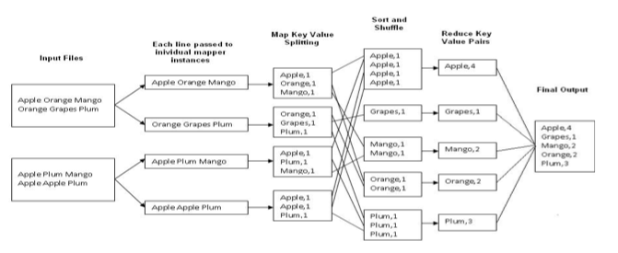
Quick MapReduce Example

Slide 10
Additional MapReduce Steps
Input reader - from HDFS
Map function
Compare function - sort keys, collect key-value pairs w/ s. key
Combiner function - reduces network traffic
Partition function - assign keys to reducer servers
Reduce function
Output writer - from HDFS

Slide 11
What’s the Big Deal with Hadooooop?
Distribution
Storage / processing across smaller machines, not supercomputers
Hardware Failure
File system / code optimized to handle server failure (frequent, usually once/day)
Node recovery - nodes can go offline and rejoin cluster w/o full restart of system
Linear Scalability
Read/write in parallel - 100TB @ 75MB/sec, 1 machine=16 days, 1000=22 min
Fault Tolerance
Both in processing (one failure doesn’t sink whole MapReduce calc) and data recovery (automatically stored on 3 blocks)

Slide 12
What’s the Big Deal with Hadooooop?
Data Locality
“Push the computation to the data”
Mapper code sent to all data nodes and run locally
No data is moved over the network for calcs -> runs faster

Slide 13
HOW TO INSTALL
From conda: pyspark
conda install -c conda-forge pyspark
From Oracle, download JDK 8 (not 13)
https://www.oracle.com/java/technologies/javase-downloads.html

